Slide 1
Reinforcement learning
Reinforcement learning (RL)is based on the idea that a computer learn as humans do — through trial and error.
RL aims for computers to learn and improve from experience rather than being explicitly instructed.

Slide 2
RL is learning through direct experimentation.
It does not assume the existence of a teacher that provides ‘training examples’ upon which learning of a task takes place.
Instead, in RL experience is the only teacher.

Slide 3
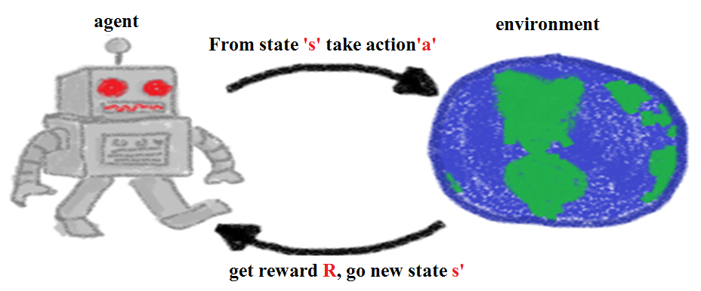
Reinforcement learning

Slide 4
Environment: the ambience or the surroundings in which the agent acts.
Agent :Interacts with an environment through a series of actions.
Agent is both:
doer - takes actions according to a learned policy, and
Receiver- recipient of rewards upon taking actions.

Slide 5
Environment for reinforcement learning-
Markov Decision Processes (MDP)
In MDPs the “present state & action” pair
holds all the information required for determining future state

Slide 6
Markov Decision Process (MDP)
At each discrete time point
Agent observes state s_{t} and chooses action a_{t} (according to some probability distribution)
Receives reward r_{t} from the environment and the state changes to s_{t+1}
Markov assumption:
r_{t} = r(s_{t}, a_{t}) s_{t+1} = δ(s_{t}, a_{t})
r_{t} and s_{t+1} depend only on the current state and action pair

Slide 7
”The future is independent of the past given the present.”
Once the current state is known, the history of information encountered so far may be thrown away, as that state is a sufficient statistic that gives us the same characterization of the future as if we have all the history.
In mathematical terms, a state S_{t} has the Markov property, if and only if;
P[S_{t+1} | S_{t} ] = P[S_{t+1} | S₁, ….. , S_{t} ],
the state captures all relevant information from history.

Slide 8
Model-free and Model-based Learning
MODEL-BASED LEARNING
( INDIRECT METHOD)
Learn from the model instead of interacting with the world
MODEL-FREE LEARNING
(DIRECT METHOD)
gain information using “trial-and-error”. without any prior knowledge of the world

Slide 9
Policies • A policy is the prescription by which the agent selects an action to perform.
–Deterministic: the agent observes the state of the system and chooses an action
– Stochastic: the agent observes the state of the system and then selects an action, at random, from some probability distribution over possible actions

Slide 10

A policy is a mapping from states to actions,
𝜋: 𝑆 → 𝐴 –
Policies can be deterministic or stochastic
𝑟(𝑡) denote the reward at time 𝑡
The objective is to find a policy that maximizes the cumulative (discounted) reward
where 𝛾 ∈ (0,1) is a discount factor necessary to make the sum converge (also applied in economic contexts to prefer future rewards at a discounted rate)

Slide 11
RL tasks have no pre-generated training sets which they can learn from — they create their own experience and learn “on the fly”
[If you do things on the fly, you do things without preparation, responding to events as they happen]

Slide 12


Slide 13
To learn “on the fly”, the Agent needs to try many different actions in different states to try and learn all available possibilities and find the path which will maximize its overall reward;
This is known as Exploration,

Slide 14
If Agent only explore, it will never maximize the overall reward — it must also use the information it learned to do so---known as Exploitation.
the Agent exploits what it learnt (its knowledge) and repeat the most rewarding path it found to maximize the rewards it receives.
The trade-off between the Exploration and Exploitation is one of the greatest challenges of Reinforcement Learning problems.

Slide 15
Exploitation:
Use current knowledge to take the optimal action
Exploration:
Take possibly suboptimal action to gather more information about the environment

Slide 16
Exploitation(greedy approach) :
Taking the action which the agent estimates to be the best at the current moment.
Agent is exploiting its current knowledge about the reward structure of the environment to act.
The opposite approach to greedy selection is to simply always take a random action- exploration.

Slide 17
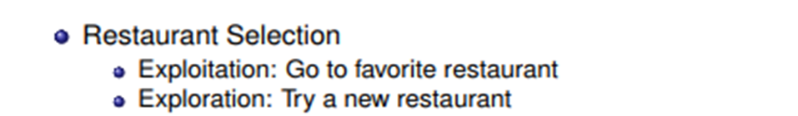
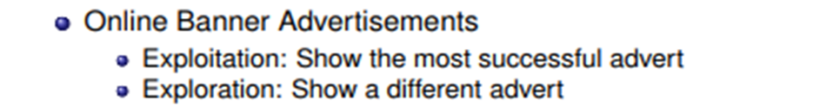
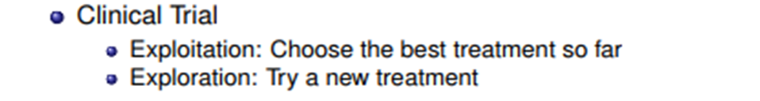
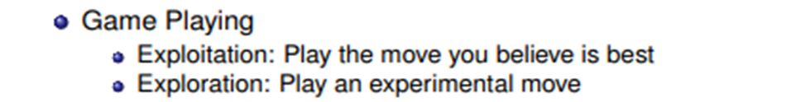

Slide 18
𝜖-greedy strategy
If 𝜖=20%, agent will take the best known action 1- 𝜖= 80% of the time, and pick a random option with a small (epsilon=20%)
Usually start with a lot of exploration (i.e. a higher value for epsilon).
Over time, it would make sense to steadily reduce epsilon to 10% or even lower as it settles into exploiting what it knows.

Slide 19
Q-learning:
learning the action-value function
Q-learning is about learning Q-values through observations.
Q-learning is a model-free reinforcement learning technique.
The ‘Q’ in Q-learning stands for quality.
Quality represents how useful a given action is in gaining some future reward.

Slide 20
Q(state, action) =
R(state, action) + γ * Max[Q(next state, all actions)]
(0 ≤ γ ≤ 1)
A value assigned to a specific element of matrix Q, is equal to the sum of the corresponding value in matrix R and the learning parameter Gamma, multiplied by the maximum value of Q for all possible actions in the next state.

Slide 21
Q(state, action) =
R(state, action) + γ * Max[Q(next state, all actions)]
γ closer to zero
the agent will tend to consider only immediate rewards
γ closer to one
the agent will consider future rewards with greater weight, willing to delay the reward

Slide 22
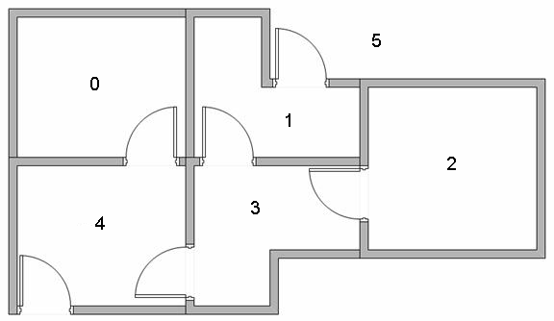
Q Learning Example
5 rooms in a building connected by doors
Outside of building is thought of as one big room (5).
Doors 1 and 4 lead from building to room 5 (Goal Room No.- outside).

Slide 23
Agent is a dumb virtual robot that can learn through experience.
The agent can pass from one room to another but has no knowledge of the environment, and doesn't know which sequence of doors lead to the outside.
Room 5 loops back to itself [self absorbing goal] .

Slide 24
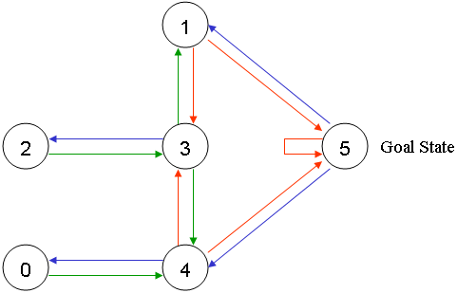
Each room is a node Each door is a link.

Slide 25
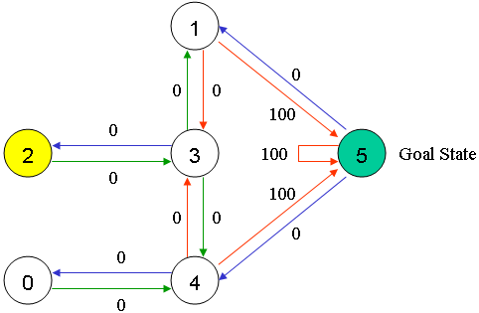
Each Room, including outside (room no 5), is called a "state“
The agent's movement from one room to another is an "action"
a "state" is depicted as a node, while "action" is represented by the arrows.

Slide 26
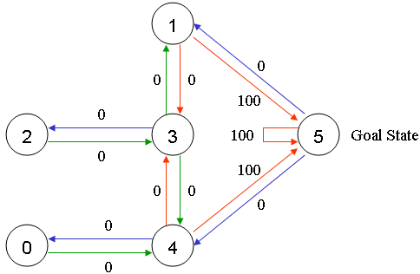
Each arrow contains an instant reward value.
A reward value is associated to each door.
The doors that lead immediately to the goal have an instant reward of 100
Otherwise reward = 0

Slide 27
In Q-learning, goal is to reach the goal with the highest reward.
If the agent arrives at the goal, it will remain there forever, called an "absorbing goal“.

Slide 28
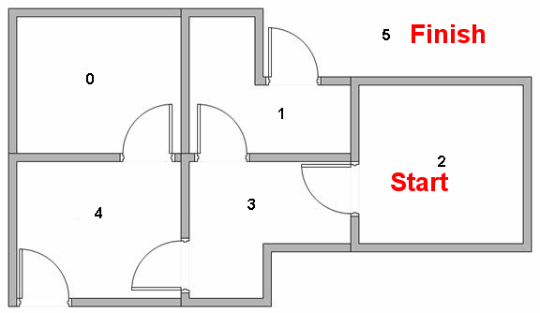
Imagine our agent as a dumb virtual robot that can learn through experience.
The agent can pass from one room to another but has no knowledge of the environment, and doesn't know which sequence of doors lead to the outside.

Slide 29
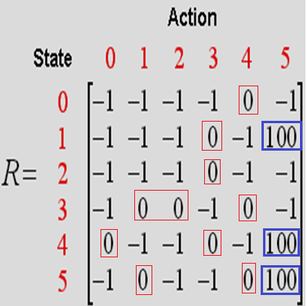
-1 : No link between nodes [ to distinguish between zero reward and no link]
0 : reward is zero
100 : reward is 100 if reaching to goal state
MAKE Reward matrix R

Slide 30
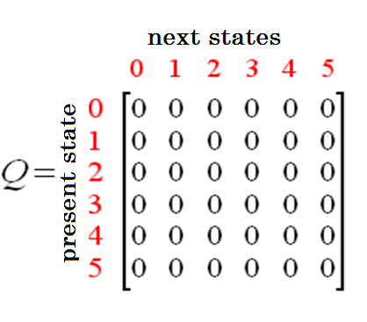
Matrix, "Q“ : representing the memory of agent what the agent has learnt through experience.
Rows : current state of the agent
Columns : possible actions leading to the next state (the links between the nodes).
Matrix Q is initialized to zero as:

Slide 31
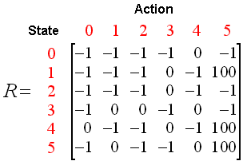
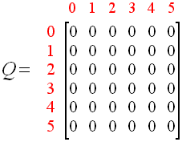
What We Have Till Now?

Slide 32
The Q-Learning algorithm :
1. Set the gamma parameter, and environment rewards in matrix R.
2. Initialize matrix Q to zero
3. For each episode:
Select a random initial state.
Do While the goal state hasn't been reached.
Select one among all possible actions for the current state.
Using this possible action, consider going to the next state.
Get maximum Q value for this next state based on all possible actions.
Compute: Q(state, action) = R(state, action) + Gamma * Max[Q(next state, all actions)]
Set the next state as the current state.
End Do
End For

Slide 33
Set learning parameter Gamma = 0.8,
initial state as Room 1.
Initialize matrix Q as a zero matrix:
By random selection, select to go to 5 as action

Slide 34
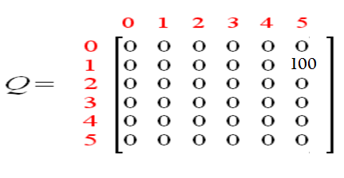
1
4
5
5
Q(state, action) = R(state, action) + Gamma * Max[Q(next state, all actions)]
Q(1, 5) = R(1, 5) + 0.8 * Max[Q(5, 1), Q(5, 4), Q(5, 5)] = 100 + 0.8 * 0 = 100
Since matrix Q is still initialized to zero, Q(5, 1), Q(5, 4), Q(5, 5), are all zero.
The next state, 5, now becomes the current state.
Because 5 is the goal state, finished one episode.
agent's brain now contains an updated matrix Q as:

Slide 35
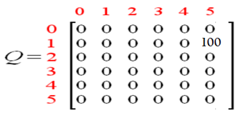
For next episode, randomly chose initial state.
choose state 3 as initial state.
By random selection, select state 1 as action.
Q(state, action) = R(state, action) + Gamma * Max[Q(next state, all actions)]
Q(3, 1) = R(3, 1) + 0.8 * Max[Q(1, 3), Q(1, 5)]
= 0 + 0.8 * Max(0, 100) = 80
update matrix Q
.
1
2
4
3
3
5
1

Slide 36
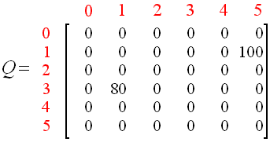
The matrix Q becomes
The next state, 1, now becomes the current state.
Repeat the inner loop of the Q learning algorithm because state 1 is not the goal state[ episode not over].

Slide 37
Set current state as 1
two possible actions: go to state 3 or to state 5.
Randomly choose action state 5.

Slide 38
Q(state, action) = R(state, action) + Gamma * Max[Q(next state, all actions)]
Q(1, 5) = R(1, 5) + 0.8 * Max[Q(5, 1), Q(5, 4), Q(5, 5)] = 100 + 0.8 * 0 = 100
1
4
5
5
Reached to goal state finish this episode.
agent's brain now contain updated matrix Q as:

Slide 39
Set current state as 4
three possible actions: go to state 3/4/5.
Randomly choose action state 5.

Slide 40
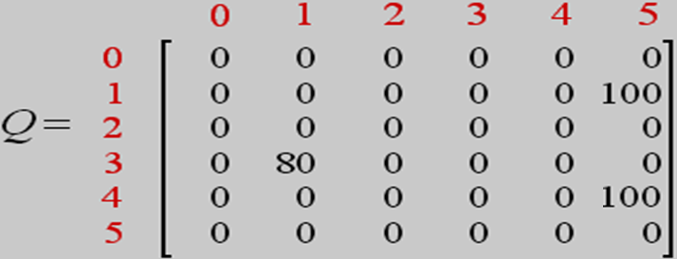
Q(state, action) = R(state, action) + Gamma * Max[Q(next state, all actions)]
Q(4, 5) = R(4, 5) + 0.8 * Max[Q(5, 1), Q(5, 4), Q(5, 5)] = 100 + 0.8 * 0 = 100
1
4
5
5
Reached to goal state finish this episode.
agent's brain now contain updated matrix Q as:

Slide 41
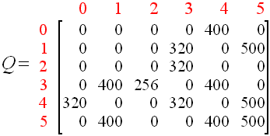
Agent learns more through further episodes
finally reach convergence values in matrix Q :Values will no longer change.
Lets check

Slide 42
Set current state as 1
two possible actions: go to state 3 or to state 5.
Randomly choose action state 5.

Slide 43
Q(state, action) = R(state, action) + Gamma * Max[Q(next state, all actions)]
Q(1, 5) = R(1, 5) + 0.8 * max[Q(5, 1), Q(5, 4), Q(5, 5)]
= 100 + 0.8 *max[400,400,500]
= 100 +0.8*500=500, NO CHANGE

Slide 44
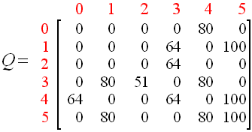
This matrix Q, can then be normalized by dividing all non-zero entries by 5 :

Slide 45
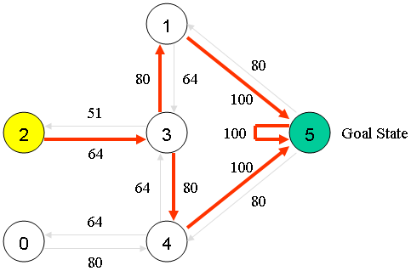
Agent has learnt the most optimal paths to the goal state through experience.
Best sequences : the links with the highest values at each state.
If we start at 2,
the best sequence is 2 - 3 - 1 – 5 or 2-3-4-5

Slide 46
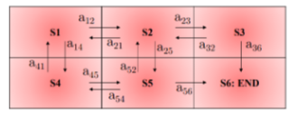

Slide 47
Example : An agent has to learn using Q learning to reach the goal state S6. Find Q values for all the following episodes:
episode1 (S3-S6) followed by episode2 (S2-S3-S6], followed by episode3 (S5-S6), followed by episode4 (S1-S2-S5-
S6).
R=100 for going to S6 (terminal state), R=0 otherwise,
discount factor (gamma)=0.5.

Slide 48
episode 1 (S3 - S6)
Q(3,6) = R(3,6) + 0.5*max[Q(6,6)]
= 100 + 0.5*max(0) = 100

Slide 49
Episode 2 (S2 - S3 - S6)
Q(2,3) = R(2,3) + 0.5*max[Q(3,6), Q(3,2)]
= 0 + 0.5*max[100, 0] = 0 + 50 = 50
Q(3,6) = R(3,6) + 0.5*max[Q(6,6)]
= 100 + 0.5*max[0] = 100

Slide 50
Episode 3 (S5 - S6)
Q(5,6) = R(5,6) + 0.5*max[Q(6,6)]
= 100 + 0.5*max(0) = 100

Slide 51
episode 4 (S1 - S2 - S5 - S6)
Q(1,2) = R(1,2) + 0.5*max[Q(2,1), Q(2,5), Q(2,3)]
= 0 + 0.5*max[0,0,50] = 25
Q(2,5) = R(2,5) + 0.5*max[Q(5,6), Q(5,2), Q(5,4)]
= 0 + 0.5*max[100, 0, 100] = 50
Q(5,6) = 100 + 0.5*max[Q(6,6)] =100

Slide 52
END

